Slide 1
Transformations
CSCI 4150/6050: Computer Vision

Slide 2

Changes of Coordinates
y
y
x
x
What if we have a point
described on one
coordinate system…
But we want to
describe it in another?

Slide 3
Why Change Coordinates?
Moving stuff around
Model in one space, place in another
Modeling hierarchically
Where are 3D points relative to the camera?
Geometric tests
Data transformations

Slide 4
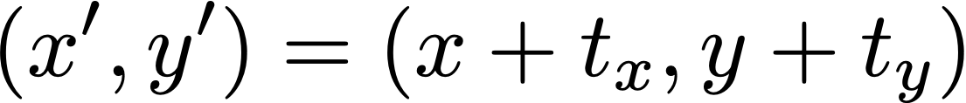
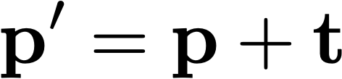
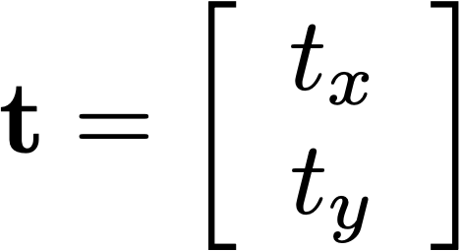
Translation
Translating a coordinate system simply moves the origin
Or can be thought of as moving the point
Keeps the x and y directions the same
Just add desired x, y offsets
Move the x and y coordinates by certain amounts
OR

Slide 5
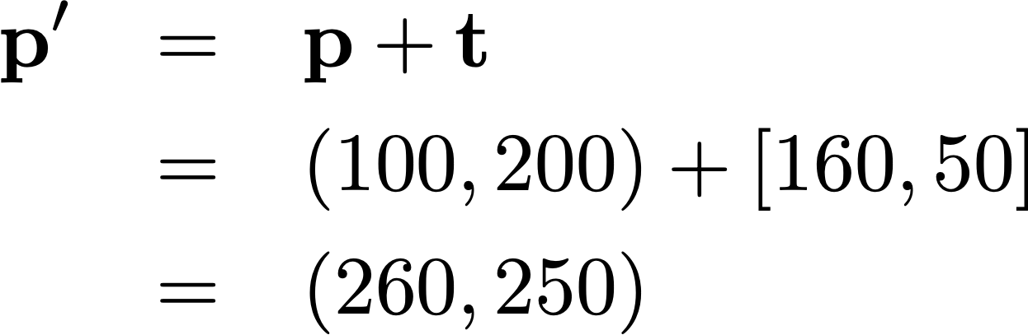
Example: Translation
Suppose that you have a point p at (100,200) and you want to translate it by [160,50]?
y
x

Slide 6
Rotation
Rotating a coordinate system keeps the origin, turns the axis directions
Conceptually,
  The point stays the same and
  the axes change
  The axes stay the same and
  the point rotates around the origin
New
Original

Slide 7

3Blue1Brown - Rotation

Slide 8






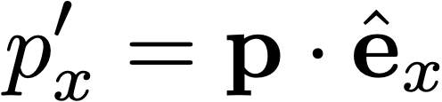
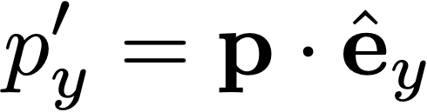
Computing Rotation
To compute coordinates in the rotated system, just project to each of the new axis directions
Use dot products!
New
Original

Slide 9
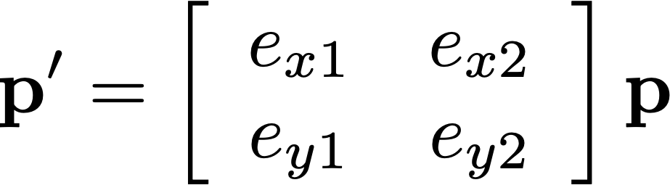
Computing Rotation
To compute coordinates in the rotated system, just project to each of the new axis directions
Use dot products!
New
But do it with a matrix!!
Original

Slide 10
Change of Coordinates
To compute coordinates in the rotated system, just project to each of the new axis directions
Use a matrix to do the dot products
New
Original

Slide 11

Rotation
Rotating the coordinate system one way rotates the point/object the other way
From here on we’ll talk in terms of rotating the point or object
New
Original

Slide 12
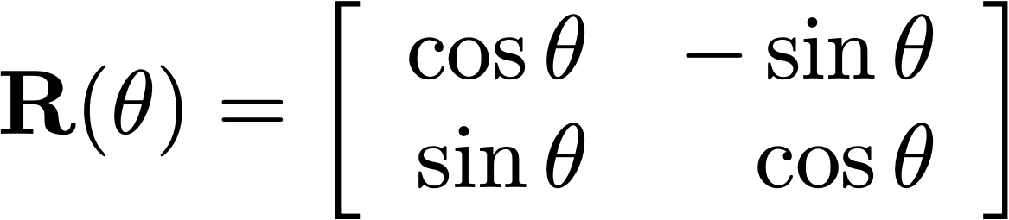
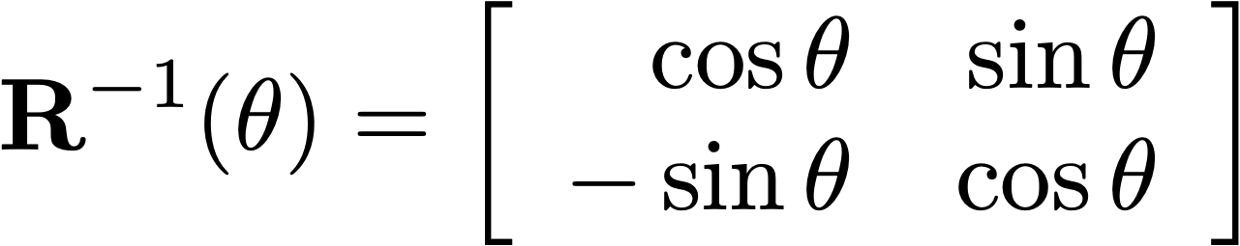
Rotation
In numpy, the angle moves in radians, so use it directly, or use ang=np.deg2rad(45) and input eg 45 degree
Counter clockwise in a right handed coordinate system
Clockwise in a left handed coordinate system
Clockwise in a right-handed coordinate system,
ie for the points and not the coordinate system?
See numpy implementation

Slide 13
Rotation
Counterclockwise in a right-handed coordinate system
or
Clockwise in a left-handed coordinate system
Clockwise in a right-handed coordinate system
or
Counterclockwise in a left-handed coordinate system

Slide 14
Let’s try it in NumPy…

Slide 15
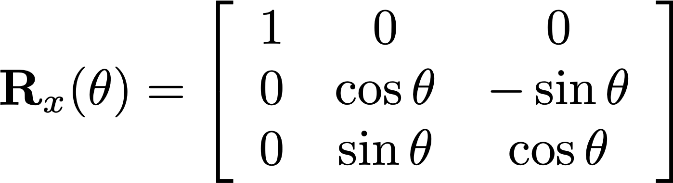
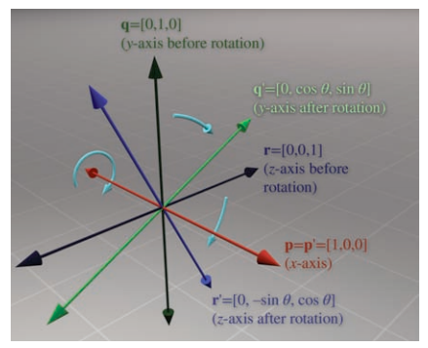
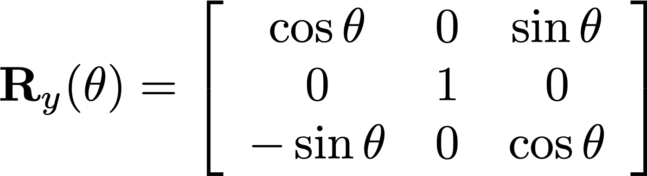
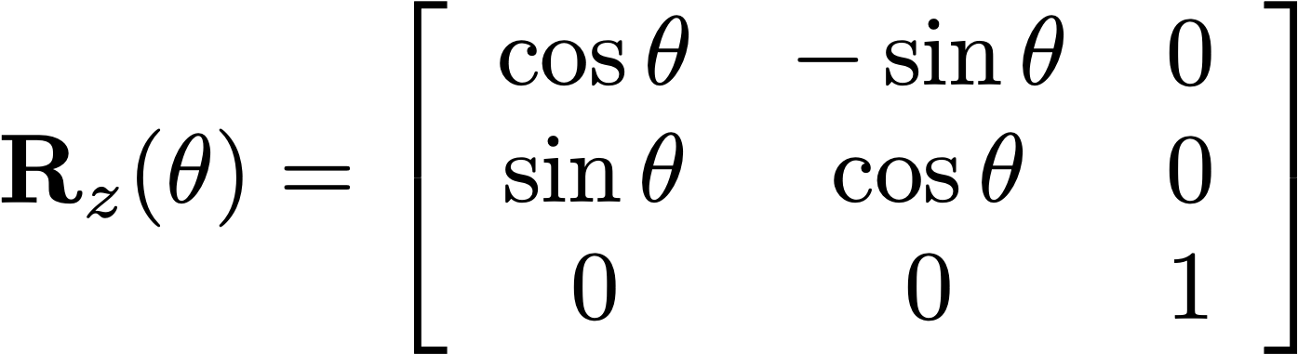
Aside: Rotation in 3D

Slide 16
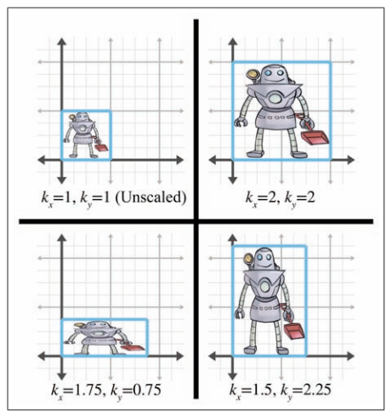
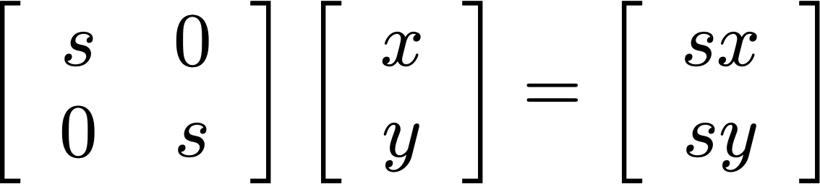
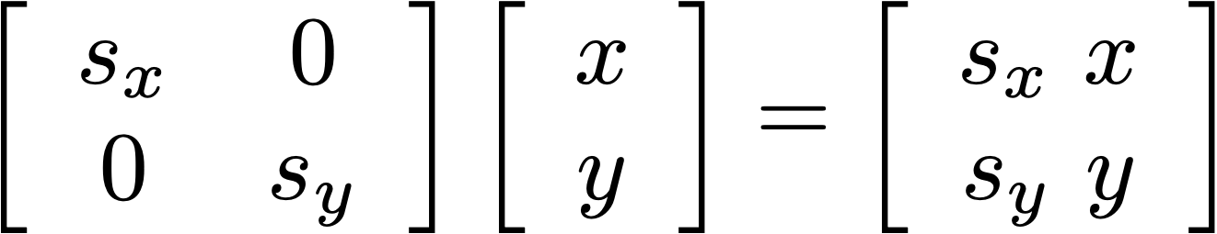
Scaling
Consistent scaling, use
Same s value on diagonal

Slide 17
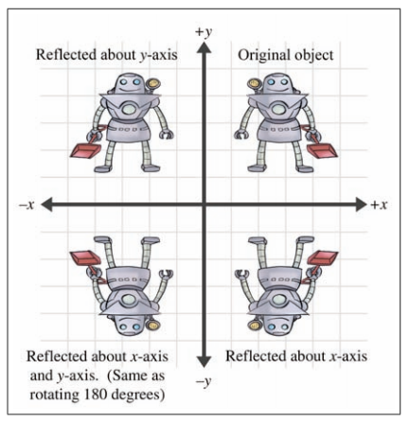
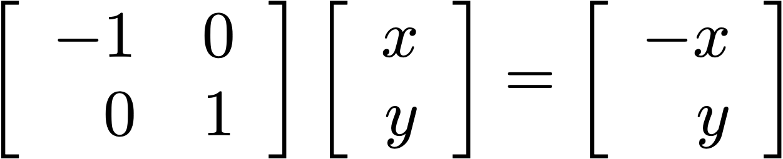
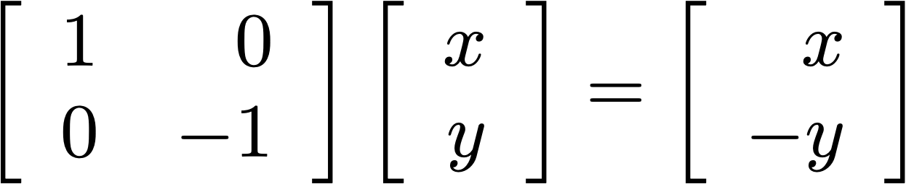
Reflection

Slide 18
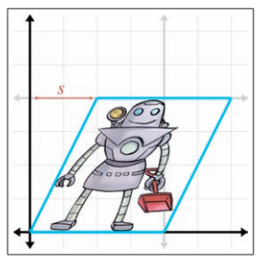
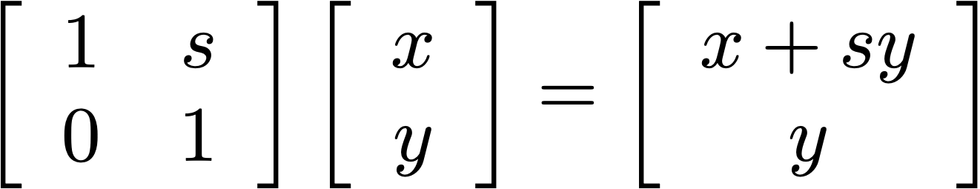
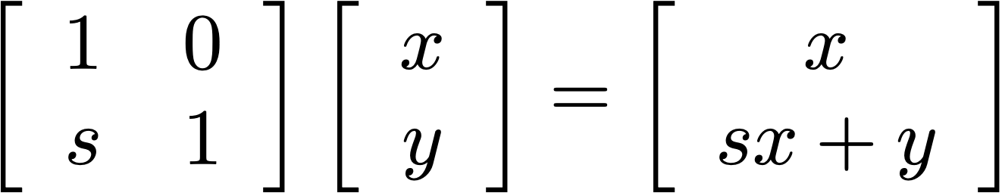
Shearing
Sometimes called a skew transform

Slide 19
3Blue1Brown - Sheer

Slide 20
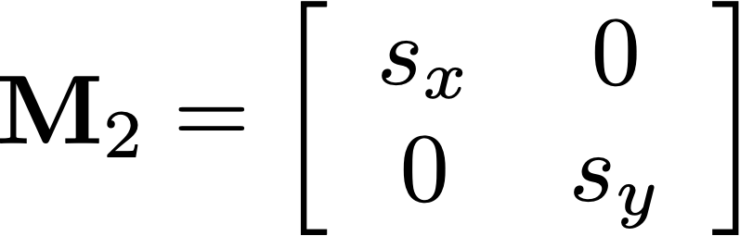
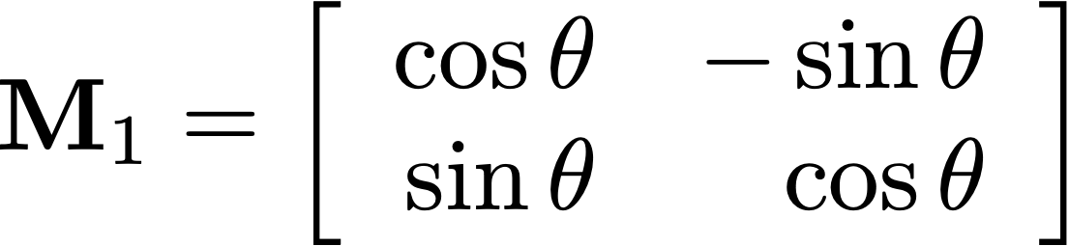

Composition

Slide 21
But...
Composition of transformations (matrix multiplication) is really useful
But translation must be done as a separate operation
Can you include translation as a linear transformation?

Slide 22
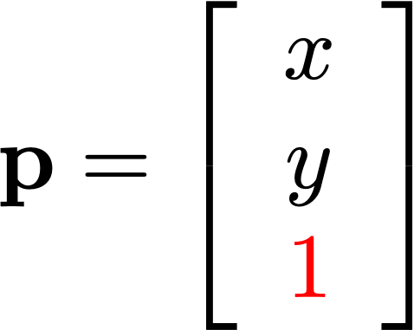
Homogeneous Coordinates
Can include translation as a linear transformation using homogeneous coordinates
Also useful for perspective
(covered later)
Add additional “homogeneous” element

Slide 23
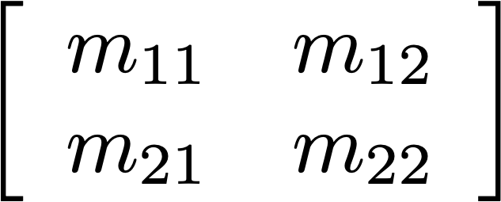
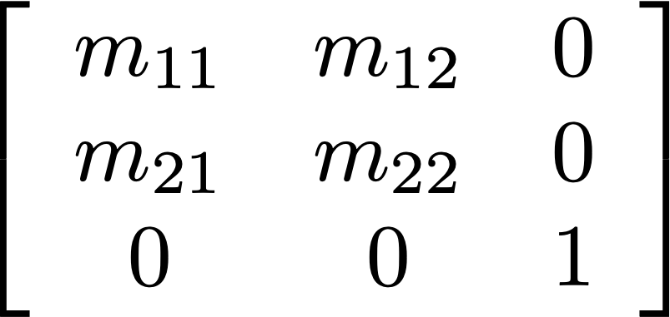
Homogeneous Matrices
To make a matrix work with homogeneous coordinates,
add an extra row and column
To do nothing else,
make these [0 0 1]

Slide 24
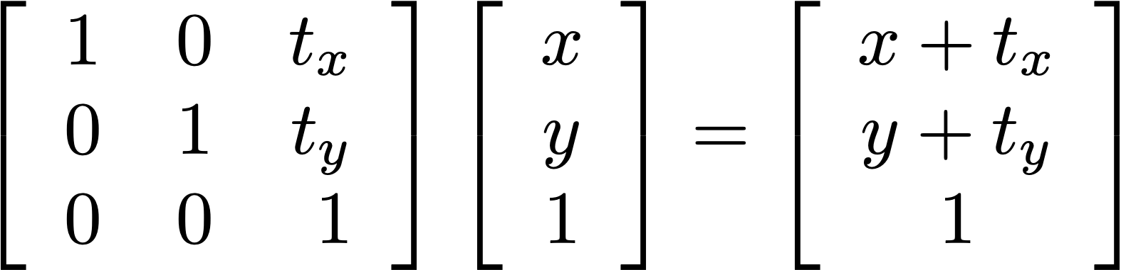
Translation
With this we can translate, rotate and scale all into a single matrix multiply instead of an additional step. So we have one matrix instead of a list of matrices and keep doing functions on it.
Keep track of the operations so you can easily revert at any time. What if you want to undo the first done function, do you revert twice spoiling everything?
(General note: for row vectors, transpose this)

Slide 25
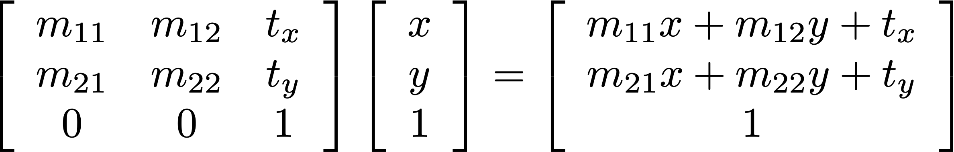
Combining With Translation
Other operation
Translation
Always [0 ... 0 1]
(for now)
Other operation then translation

Slide 26
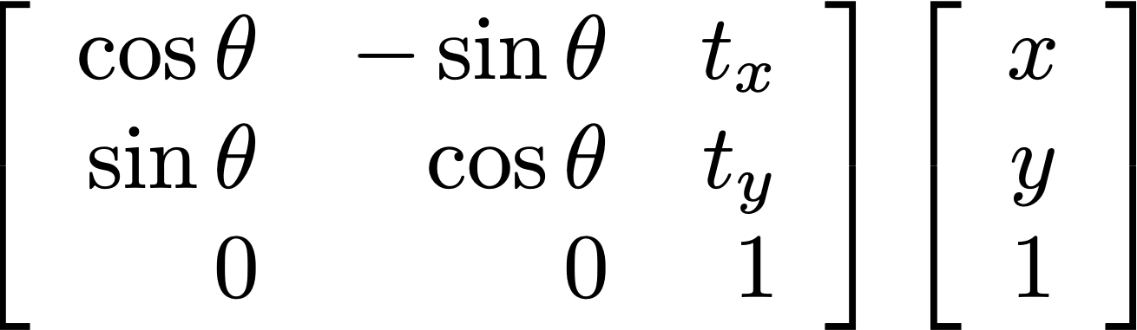
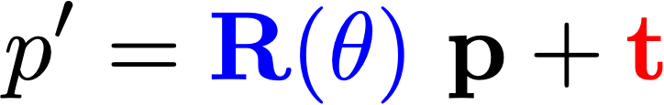
Rotation then Translation
Rotation
Translation

Slide 27
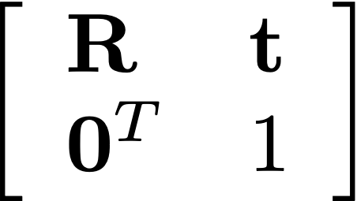
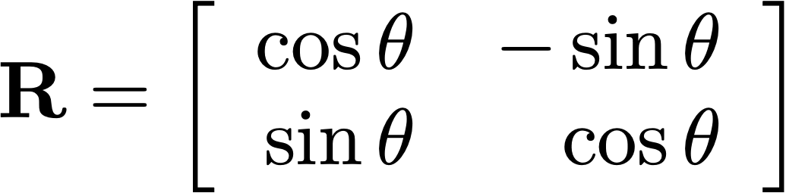
Rotation then Translation
Rotation
Translation

Slide 28
The “Big Three” Transformations
Lab3
See example in class code
Translation
Scaling
$T=\left[\begin{matrix}1 & 0 & t_{x} \\ 0 & 1 & t_{y} \\ 0 & 0 & 1\end{matrix}\right]$
$S=\left[\begin{matrix}s_{x} & 0 & 0 \\ 0 & s_{y} & 0 \\ 0 & 0 & 1\end{matrix}\right]$
*Rotation
$R=\left[\begin{matrix}cos⁡\left(θ\right) & −sin⁡\left(θ\right) & 0 \\ sin⁡\left(θ\right) & cos⁡\left(θ\right) & 0 \\ 0 & 0 & 1\end{matrix}\right]$
*In a right-handed coordinate system

Slide 29
Let’s try it in NumPy…

Slide 30
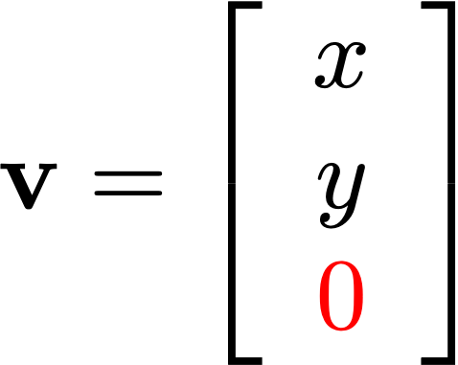
Points vs. Vectors
allows translation
ignores translation
Remember: points have a position and can be translated,
but vectors are only a displacement and cannot be translated

Slide 31
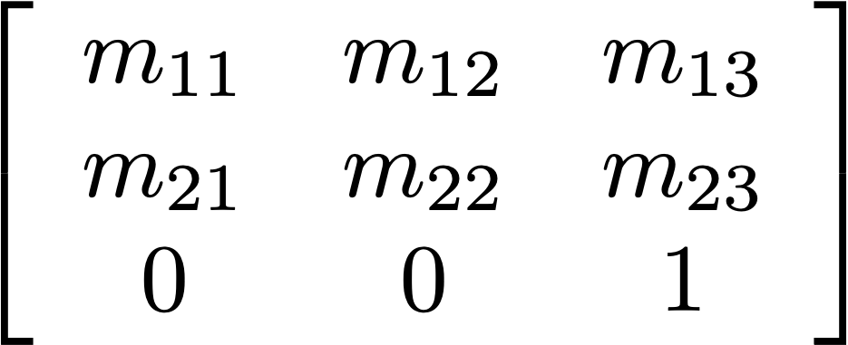
Classes of Transformations
Euclidean / Rigid body (preserves lengths):
Rotation and translation
Similarity (preserves angles):
Rotation, translation, scale
Affine (preserves straight lines):
Arbitrary linear combinations
Ie any combination of the top 6 values in the matrix, not that the last row always stays constant
And is just there for calculation putposes. So affine includes translation, scale, and rotation as well.
General form of an
affine transformation

Slide 32
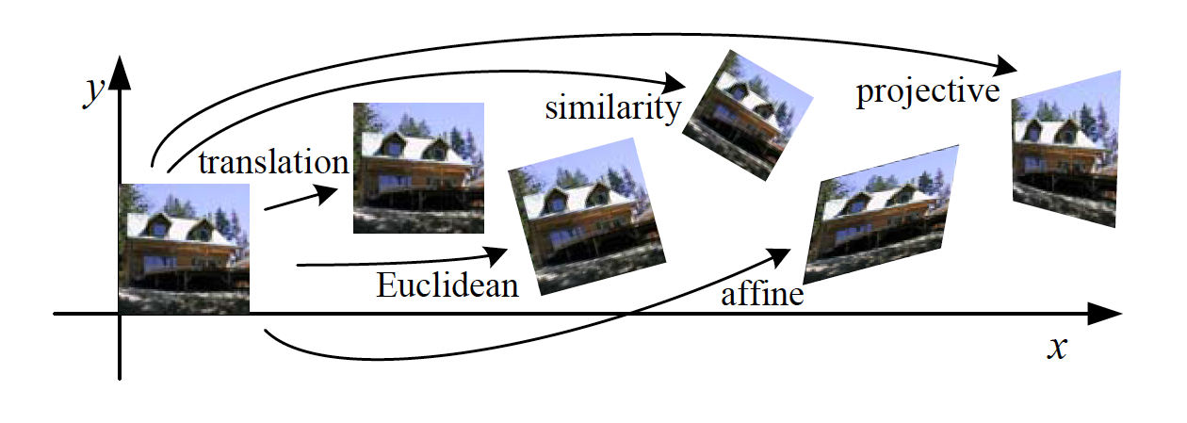
Classes of Transformations

Slide 33



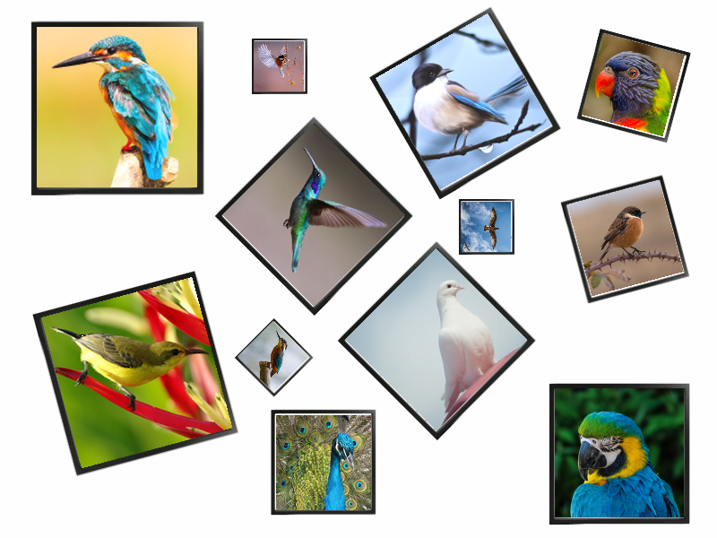









Lab 3

Slide 34
Lab 3
This is the order everything should be done so the operations should be relative to the center.
Original
Scale
Rotate
Translate

Slide 35
Coming up...
  Camera geometry and projection
  Perspective transormations

